Slide 1

Space Range and Display- Ranging
Somnath Bardhan

Slide 2
What is Assort
Assort™ is a tool that helps us react quickly to customer needs and plan assortments that meet the demands of a changing marketplace
Assort is a product of Retek Inc.’s Supply Chain Management Solutions, which helps us plan at all levels − from marketing and financial plans to specific assortment and key item plans.

Slide 3
Systems Overview
Ranging
Controls
CW
(product
Info)
Ranging
System
ProSpace
ProSpace
VMCS
Ranges in
Progress
VMCS
Supply Chain
Stores

Slide 4
I/O for the ranging system
INPUT
Event dates and Description from Schedule
Cluster details, Overlays and exceptions from Store Clustering
Space Break, range class from Supported Space matrix
Product information and store location Information from RMS
Financial summary and Sales data from datawarehouse
Last Authorized range from Ranges in progress
OUTPUT
Dummy new Lines for new products
Cluster ranging
Overlay ranging
Sales Forecast for products ranged
Range Validation Summary

Slide 5
The Ranging System

Slide 6
System Overview
LOGIN
Select Workbook and Merch Group
(Dummy) New Lines
Ranging
Sales History
Live Ranges
Setting up Dummy
New Lines
Buddy Forecast
Cluster Ranging
Overlay Ranging
Range Validation
Financial Summary
Summary
Send & Submit

Slide 7
Dummy New Lines
Set-up
Linking
Parameters
LOGIN
Select Workbook and Merch Group
(Dummy) New Lines
Ranging
Sales History
Live Ranges
Setting up Dummy
New Lines
Buddy Forecast
Cluster Ranging
Overlay Ranging
Range Validation
Financial Summary
Summary
Send & Submit
Notes:
If you plan to introduce a new line into the range and it is not yet authorised in CW, you need to set up a Dummy New Line in the Ranging System
If you do not set up dummy new lines, you will not be able to range them in the Ranging Workbook

Slide 8
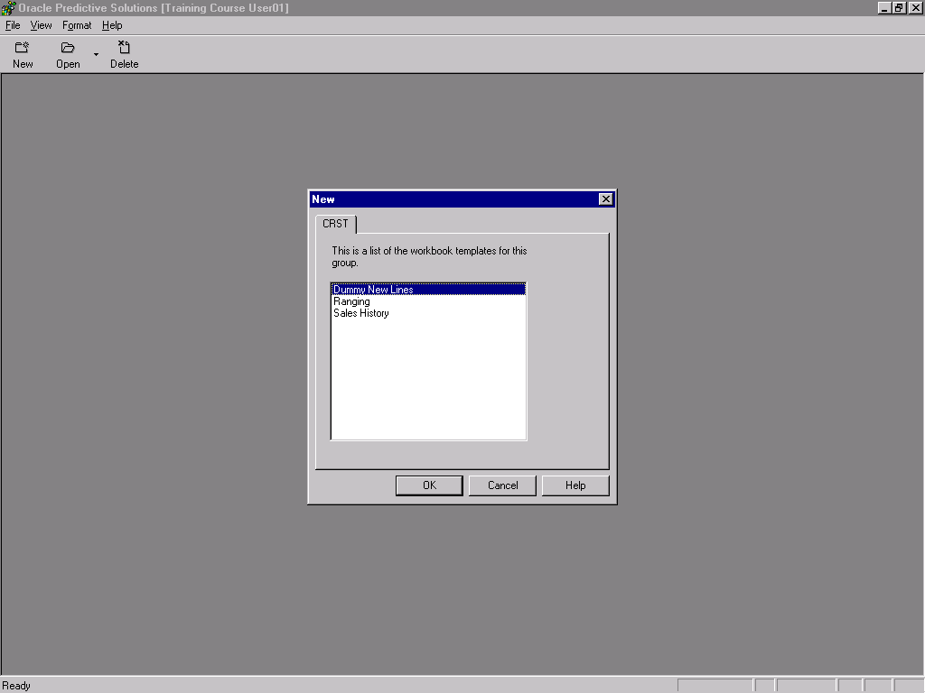

Slide 9
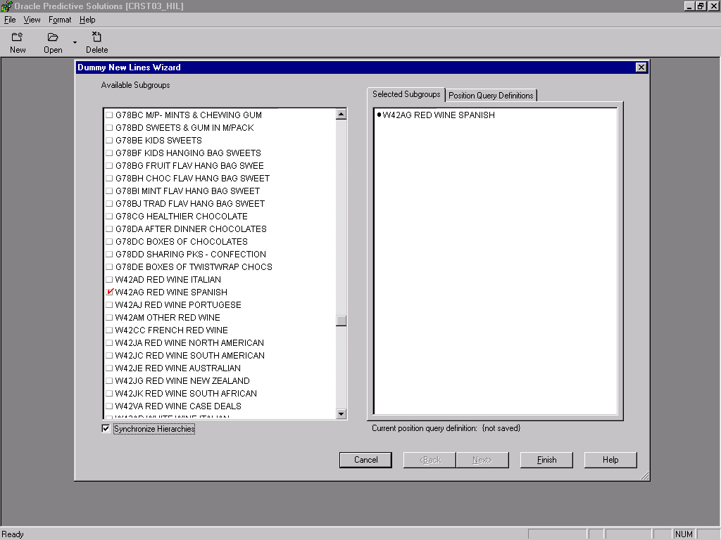

Slide 10
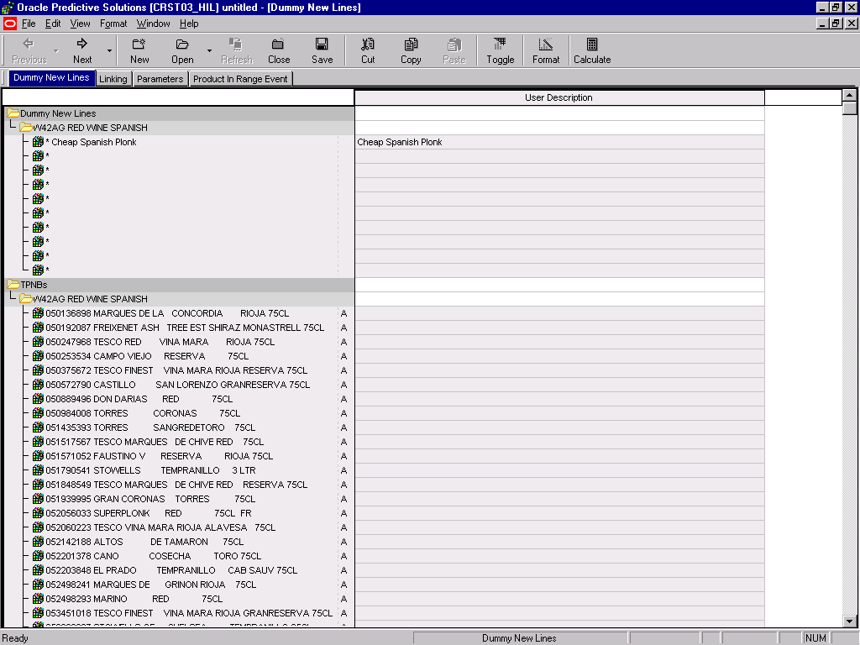

Slide 11
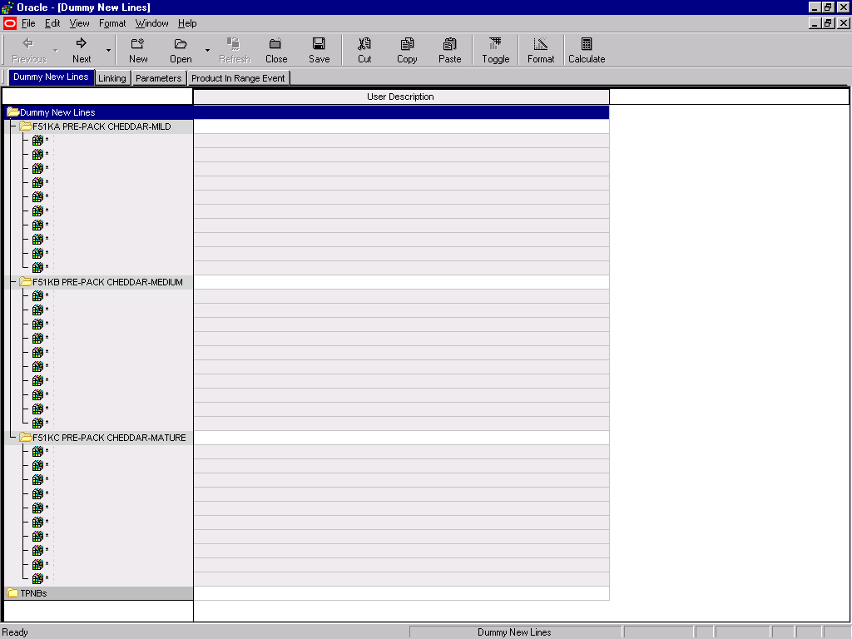

Slide 12
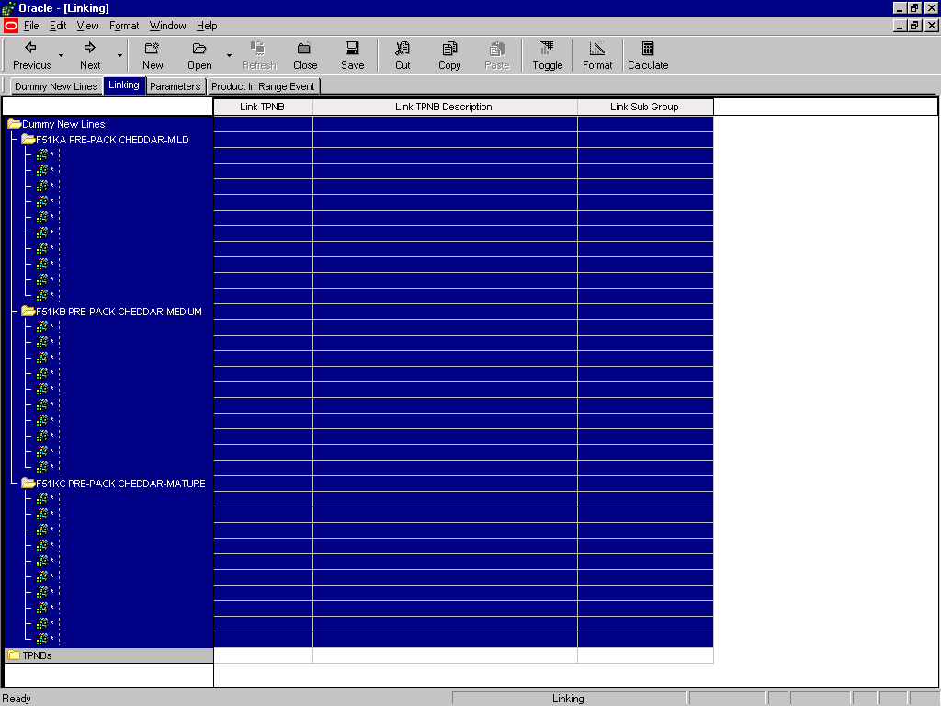

Slide 13
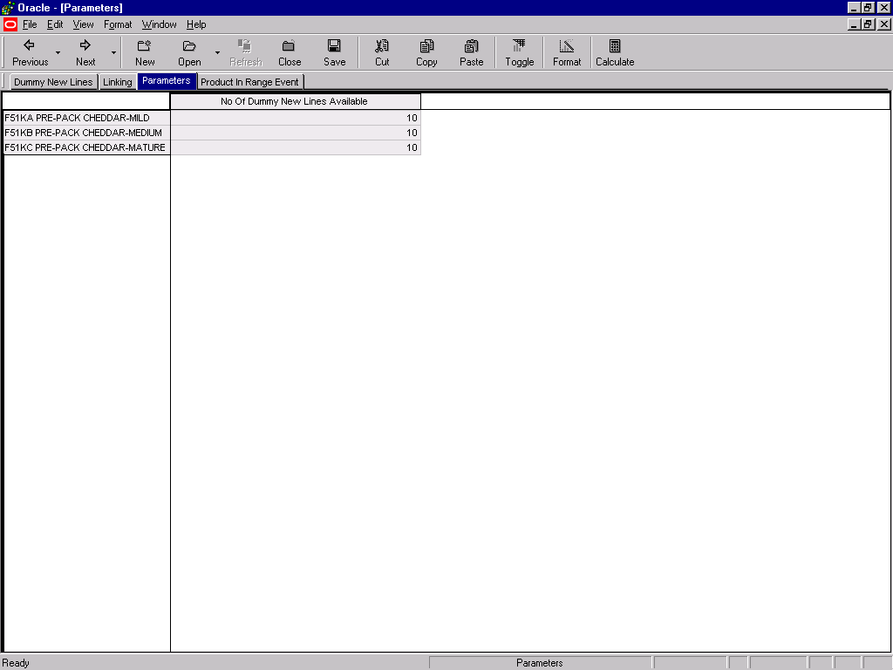

Slide 14
Ranging

Slide 15
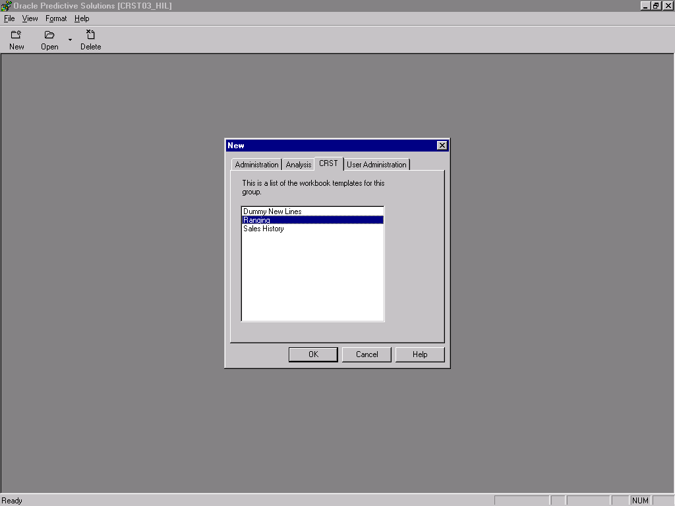

Slide 16
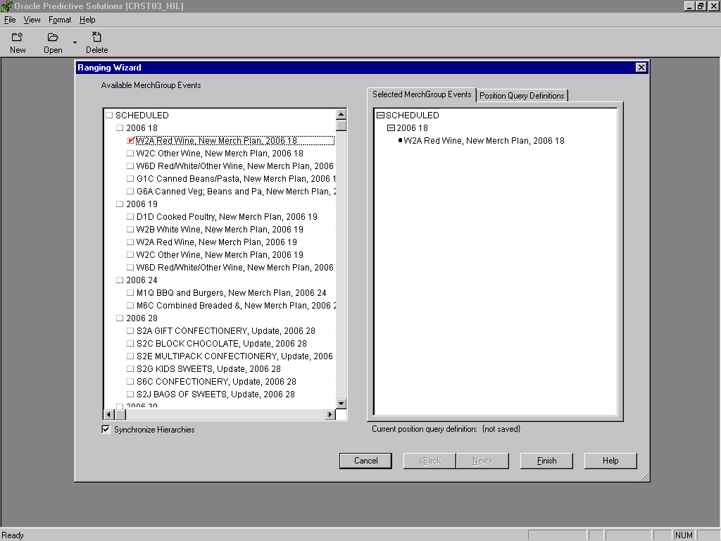

Slide 17
Sales/Buddy Forecast
Linking Dummy Products Sales Forecasts
Adjusting the Sales Forecast
Sorting
LOGIN
Select Workbook and Merch Group
(Dummy) New Lines
Ranging
Sales History
Live Ranges
Setting up Dummy
New Lines
Buddy Forecast
Cluster Ranging
Overlay Ranging
Range Validation
Financial Summary
Summary
Send & Submit

Slide 18
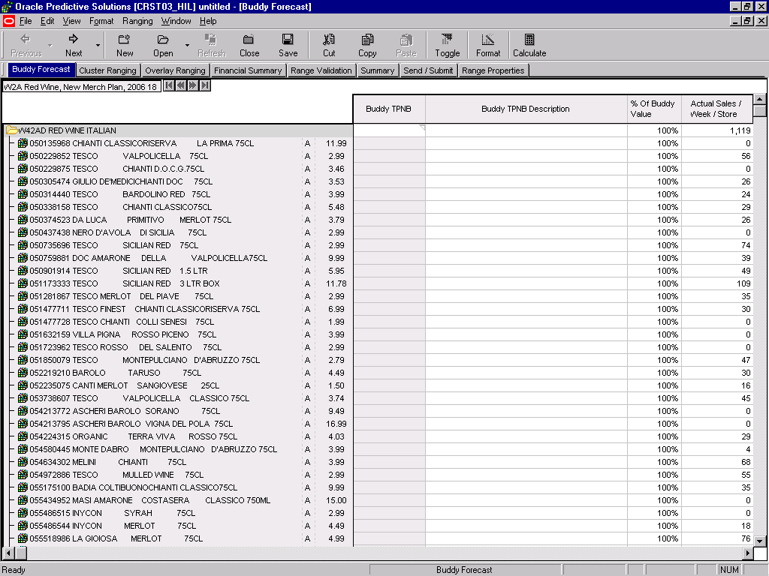

Slide 19
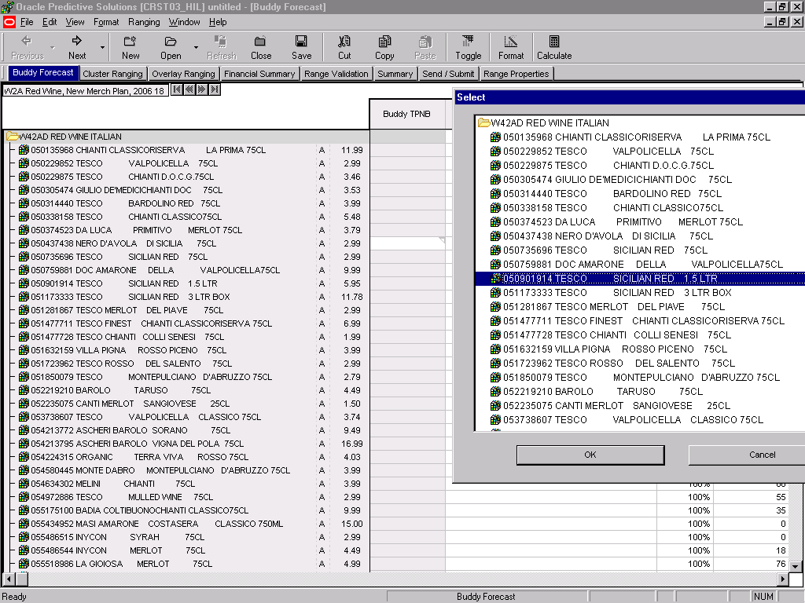

Slide 20
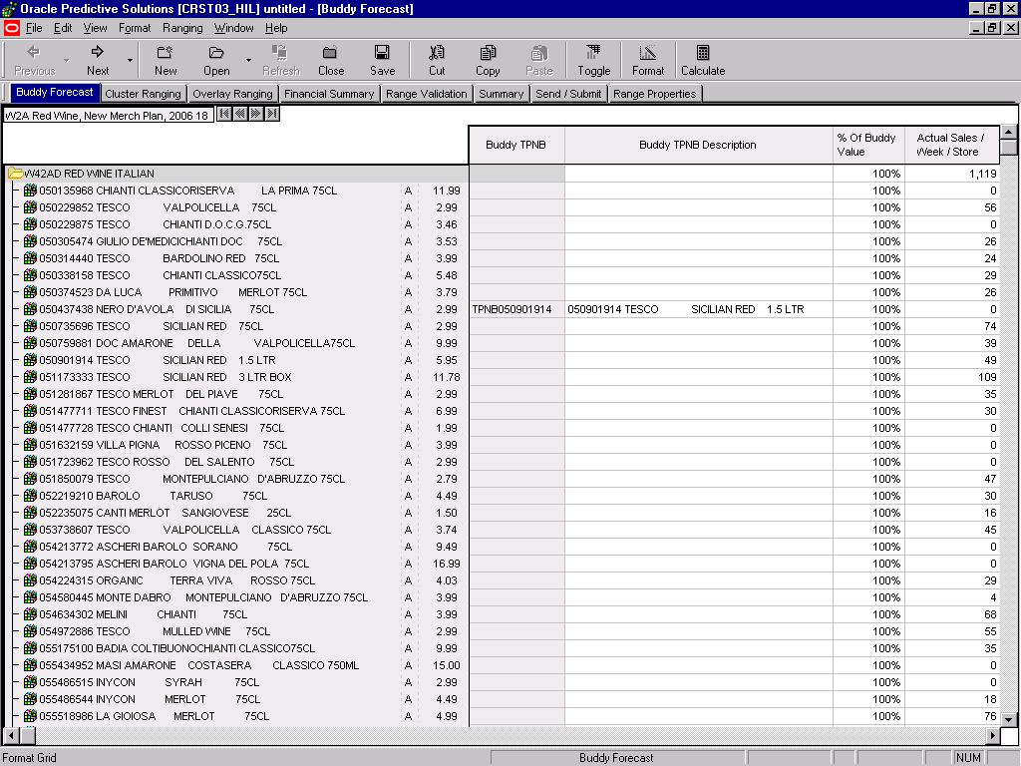

Slide 21
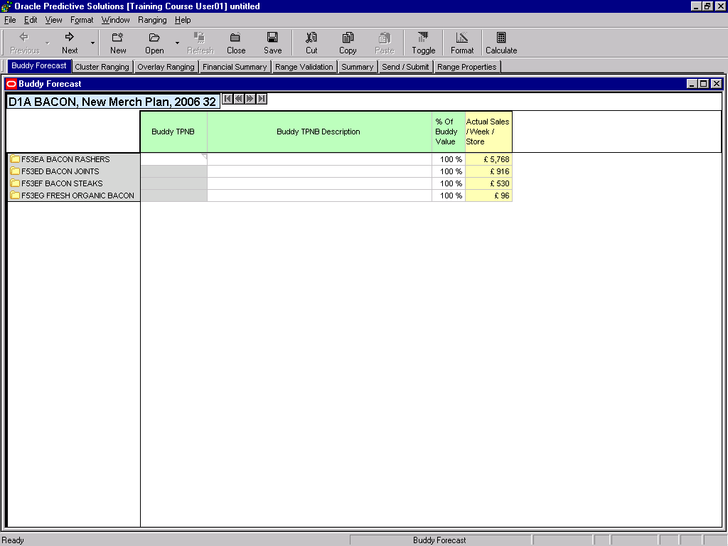

Slide 22
Cluster Ranging
All Range Classes & Store Count Windows
Individual Range Class Window and Forecasting
Show and hide
LOGIN
Select Workbook and Merch Group
(Dummy) New Lines
Ranging
Sales History
Live Ranges
Setting up Dummy
New Lines
Buddy Forecast
Cluster Ranging
Overlay Ranging
Range Validation
Financial Summary
Summary
Send & Submit

Slide 23
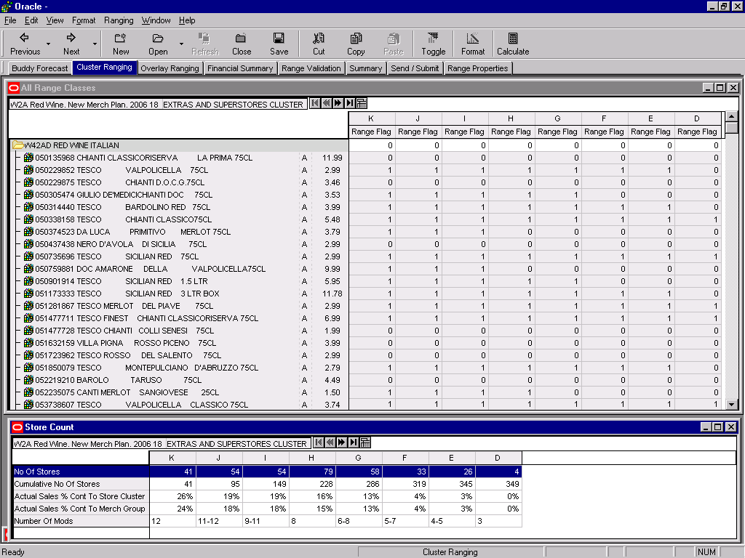

Slide 24
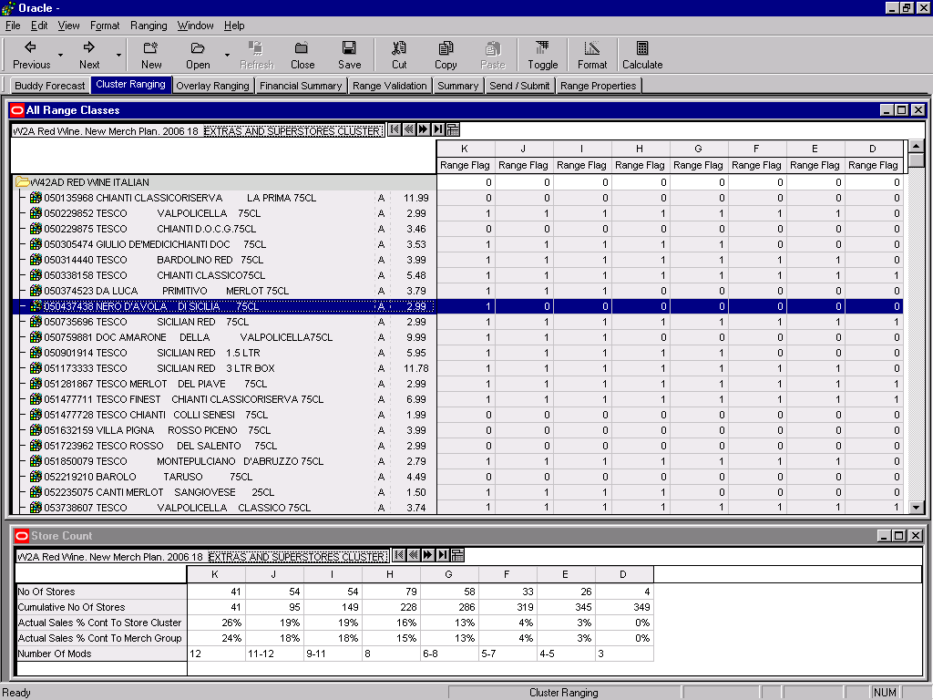

Slide 25
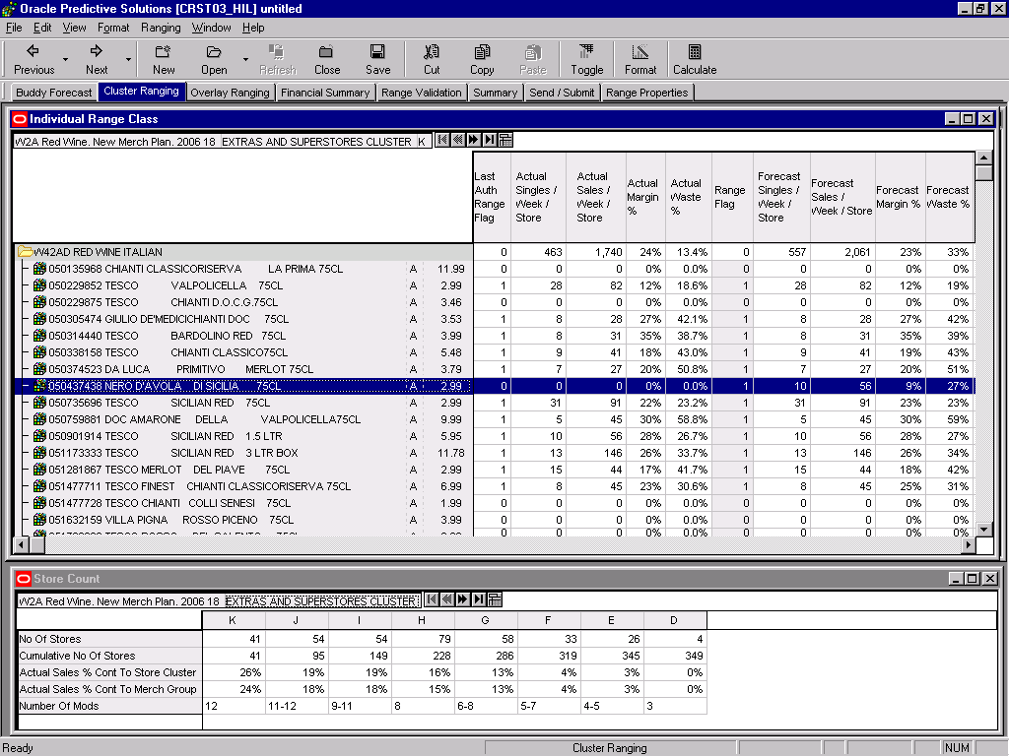

Slide 26
Overlay Ranging
Substituting Core products with an Overlays
Removing overlays
Errors to look out for
LOGIN
Select Workbook and Merch Group
(Dummy) New Lines
Ranging
Sales History
Live Ranges
Setting up Dummy
New Lines
Buddy Forecast
Cluster Ranging
Overlay Ranging
Range Validation
Financial Summary
Summary
Send & Submit

Slide 27
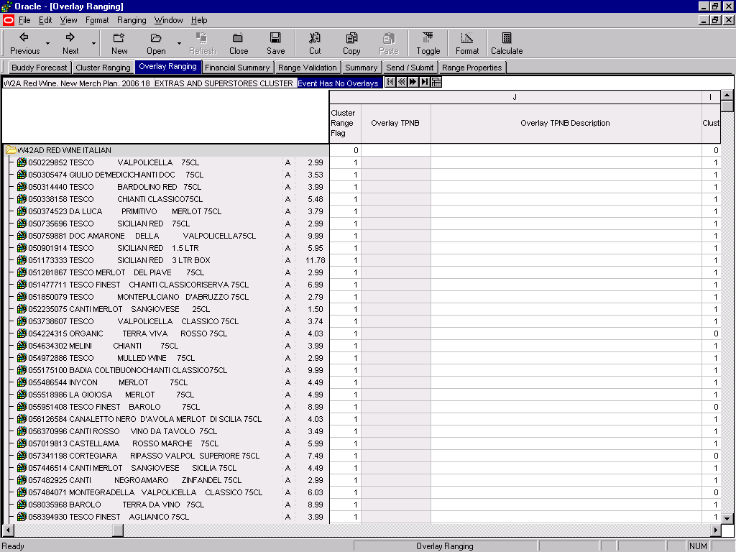

Slide 28
Financial Summary
Financial summary
Rate of sale
LOGIN
Select Workbook and Merch Group
(Dummy) New Lines
Ranging
Sales History
Live Ranges
Setting up Dummy
New Lines
Buddy Forecast
Cluster Ranging
Overlay Ranging
Range Validation
Financial Summary
Summary
Send & Submit

Slide 29
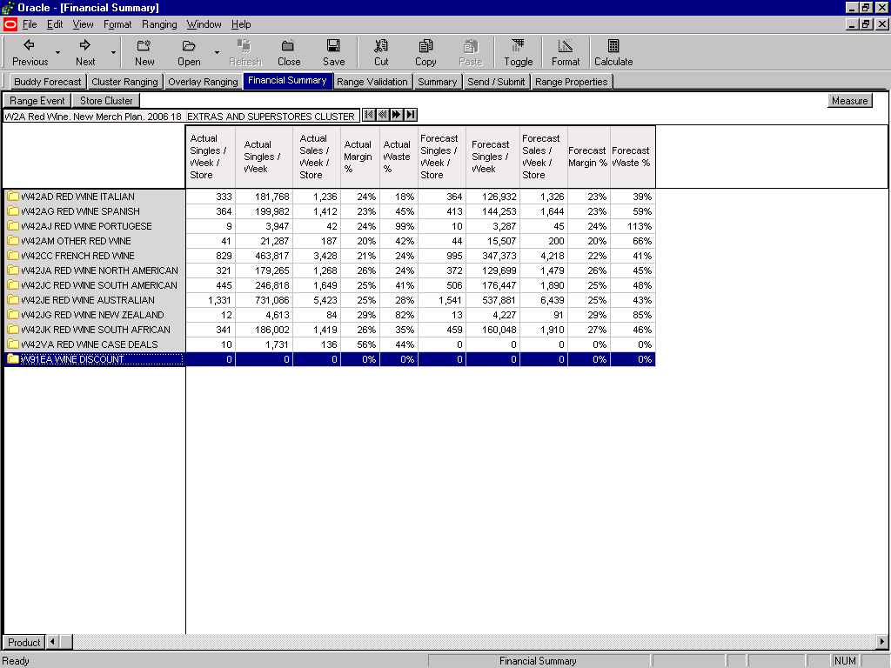

Slide 30
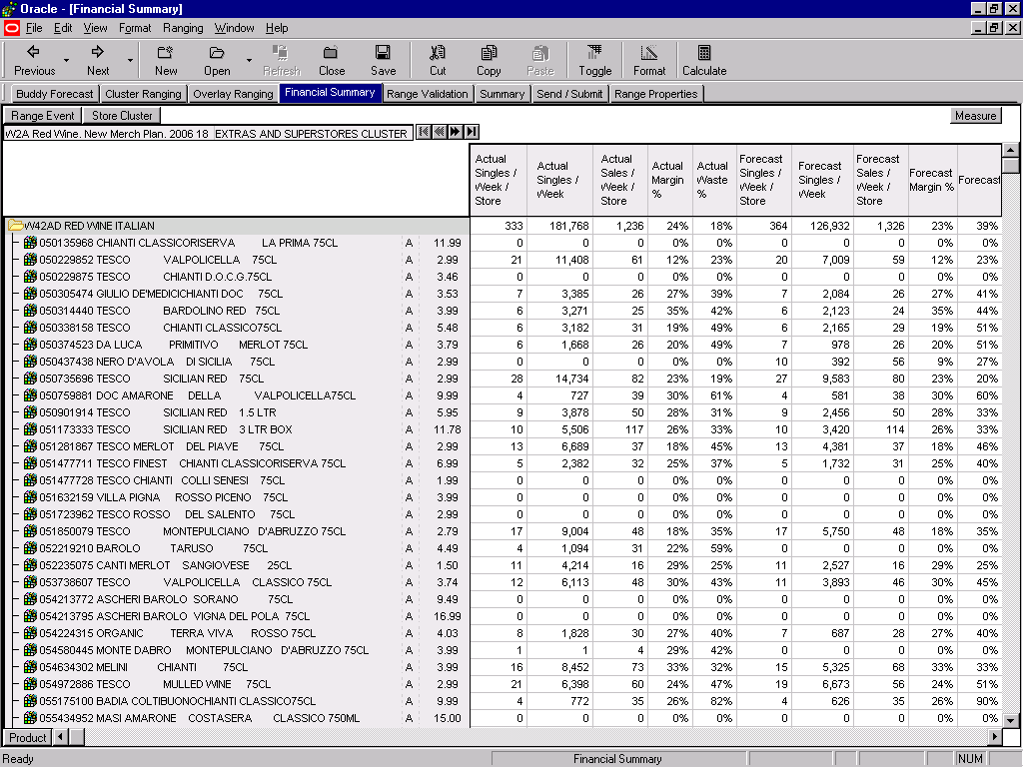

Slide 32
Range Validation
The Range Validation Screen
Ensuring Ranges are valid and can be authorised
LOGIN
Select Workbook and Merch Group
(Dummy) New Lines
Ranging
Sales History
Live Ranges
Setting up Dummy
New Lines
Buddy Forecast
Cluster Ranging
Overlay Ranging
Range Validation
Financial Summary
Summary
Send & Submit

Slide 33
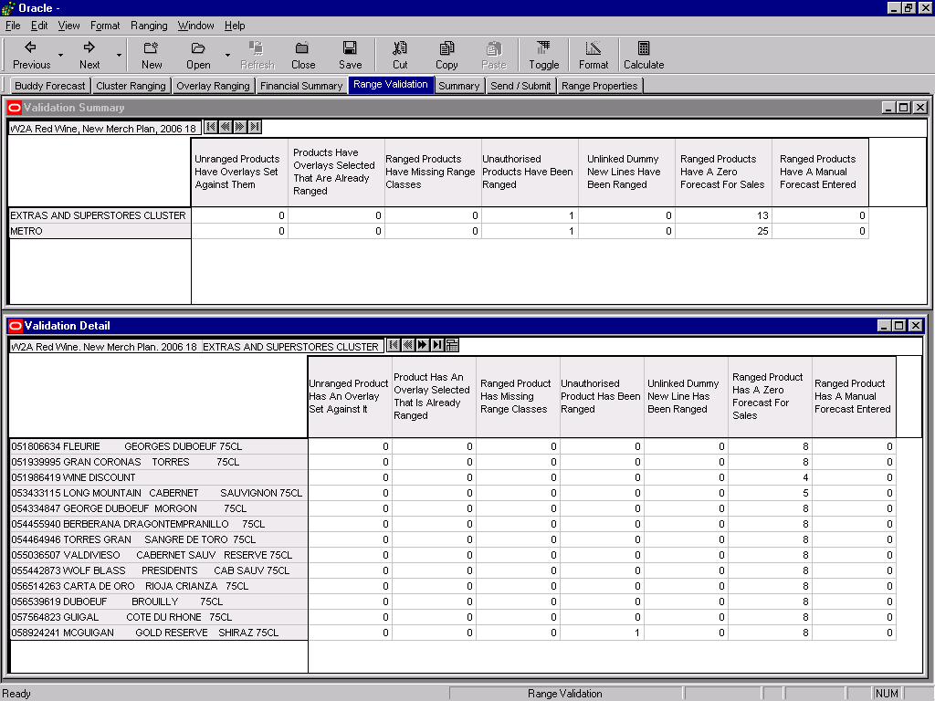

Slide 34
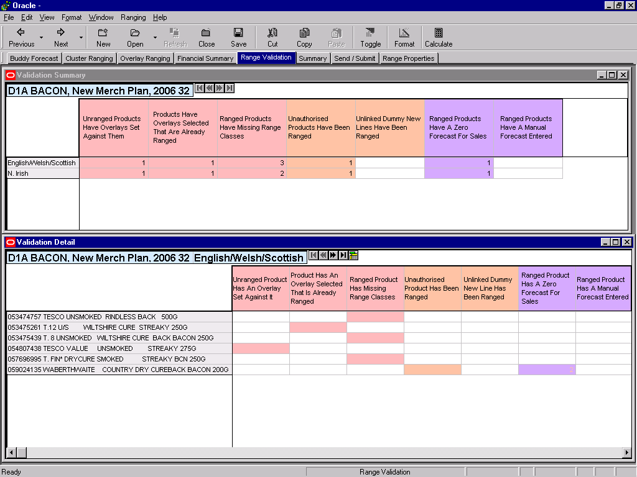

Slide 35
Summary Tab
Store Count
Range Class Summary
LOGIN
Select Workbook and Merch Group
(Dummy) New Lines
Ranging
Sales History
Live Ranges
Setting up Dummy
New Lines
Buddy Forecast
Cluster Ranging
Overlay Ranging
Range Validation
Financial Summary
Summary
Send & Submit

Slide 36
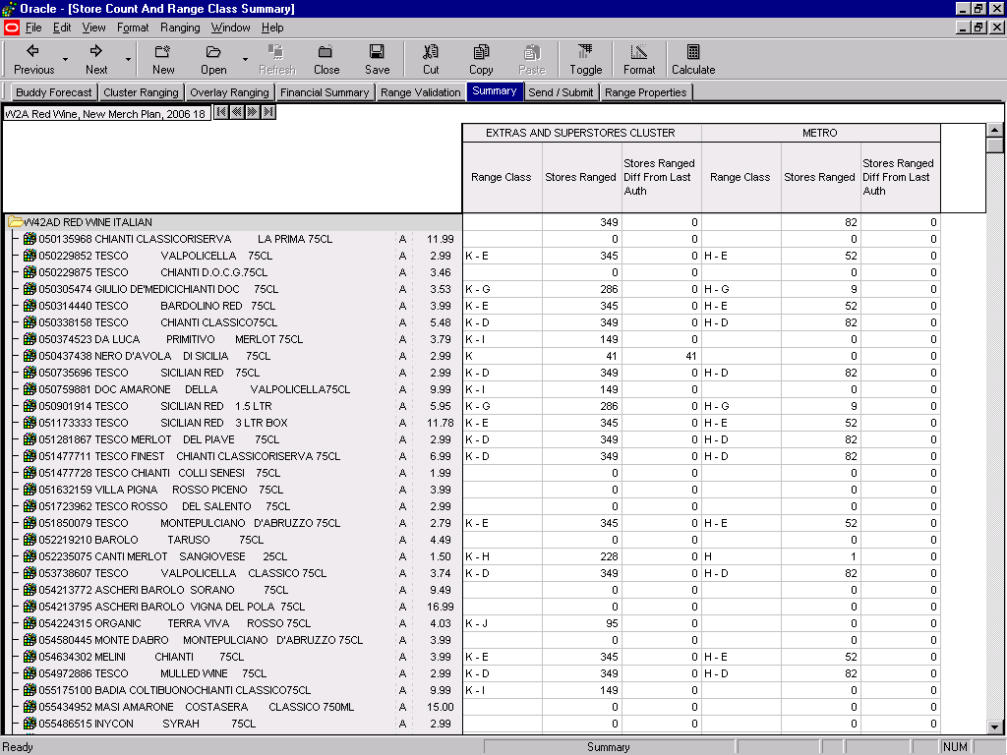

Slide 37
Send and Submit
Sending Ranging Plans to RIP
Submitting Ranging Plans to RIP
LOGIN
Select Workbook and Merch Group
(Dummy) New Lines
Ranging
Sales History
Live Ranges
Setting up Dummy
New Lines
Buddy Forecast
Cluster Ranging
Overlay Ranging
Range Validation
Financial Summary
Summary
Send & Submit

Slide 38
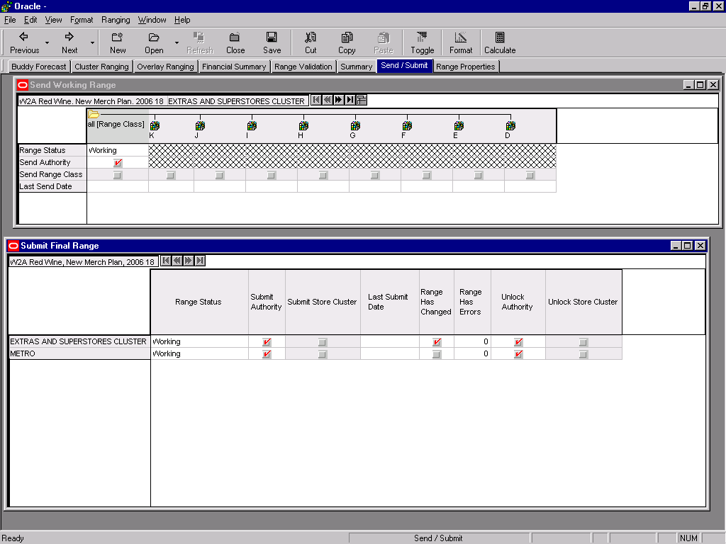

Slide 39
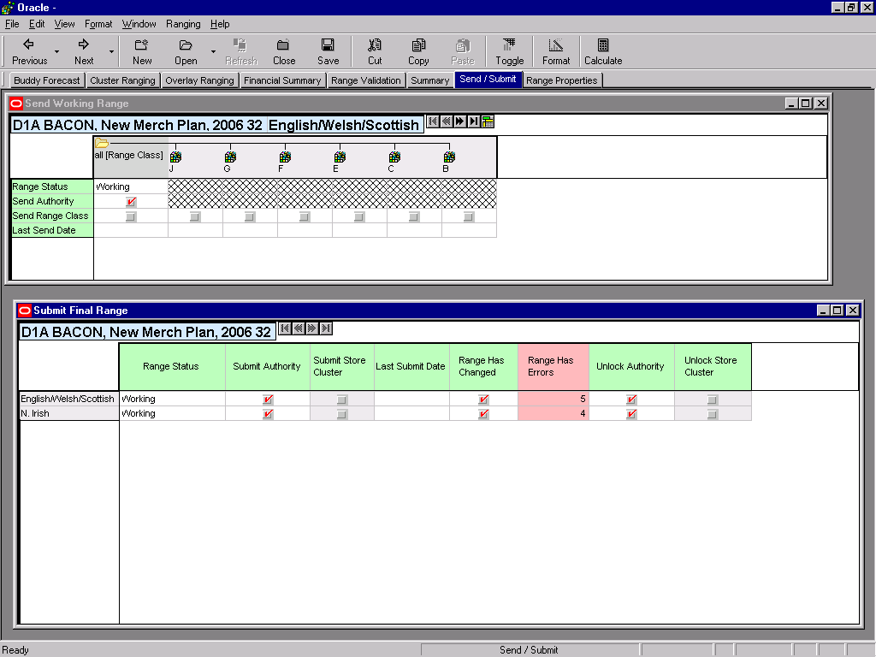

Slide 40
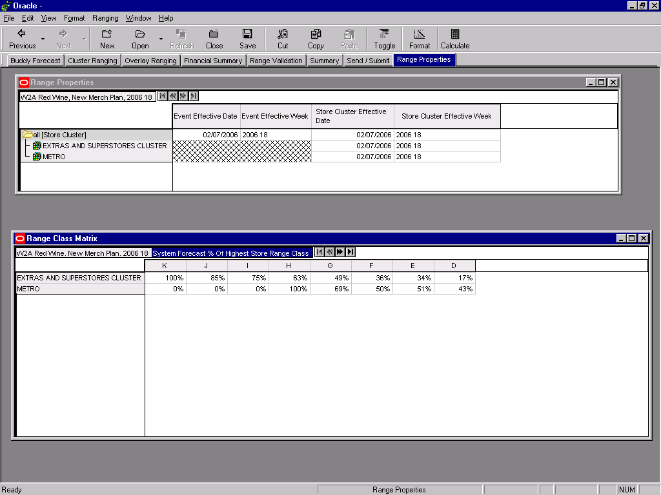

Slide 41
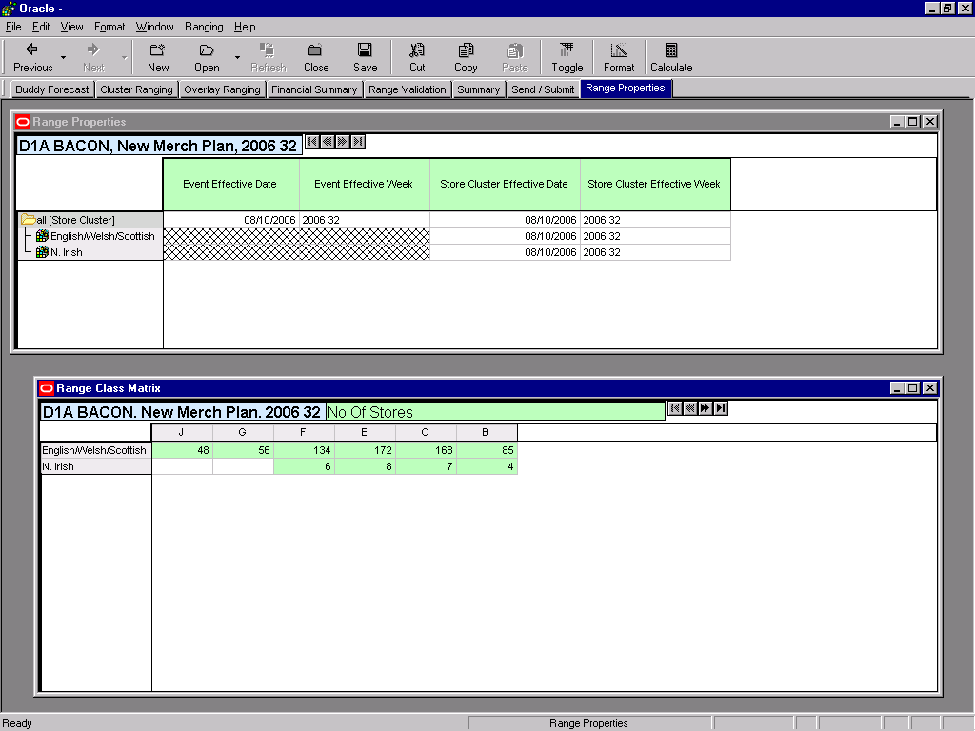

Slide 42
Sales History
Accessing Sales History
LOGIN
Select Workbook and Merch Group
(Dummy) New Lines
Ranging
Sales History
Live Ranges
Setting up Dummy
New Lines
Buddy Forecast
Cluster Ranging
Overlay Ranging
Range Validation
Financial Summary
Summary
Send & Submit

Slide 43
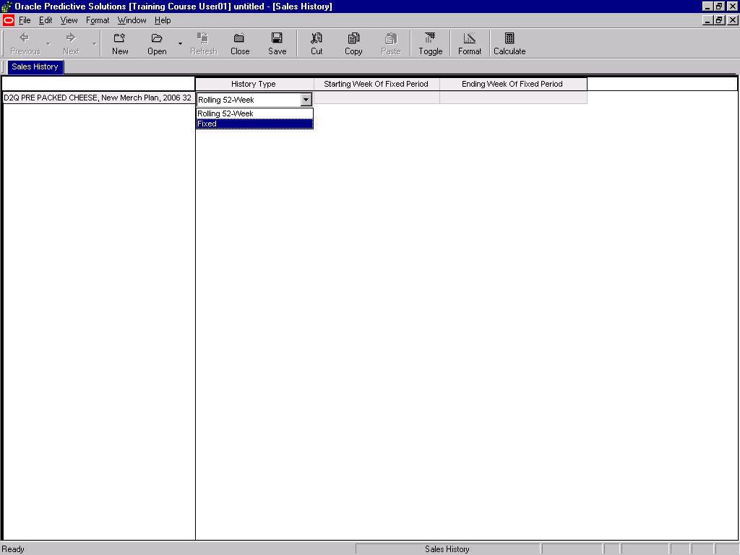

Slide 44
Live Ranges Workbook
Accessing Live Ranges
LOGIN
Select Workbook and Merch Group
(Dummy) New Lines
Ranging
Sales History
Live Ranges
Setting up Dummy
New Lines
Buddy Forecast
Cluster Ranging
Overlay Ranging
Range Validation
Financial Summary
Summary
Send & Submit

Slide 45
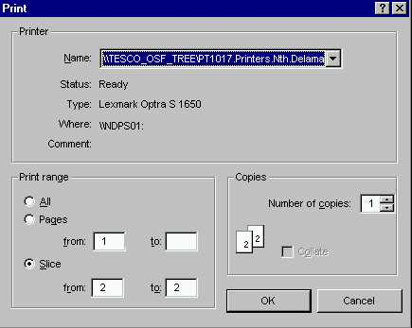
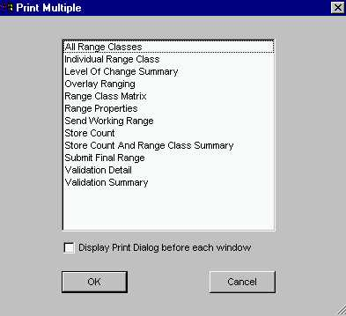
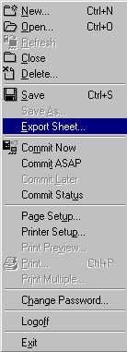
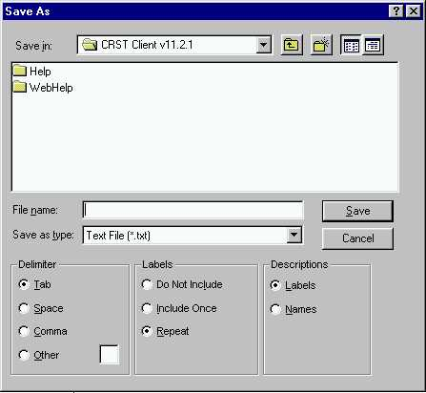
Other Useful Functions
Print
Print Multiple
Export

